Slide 1
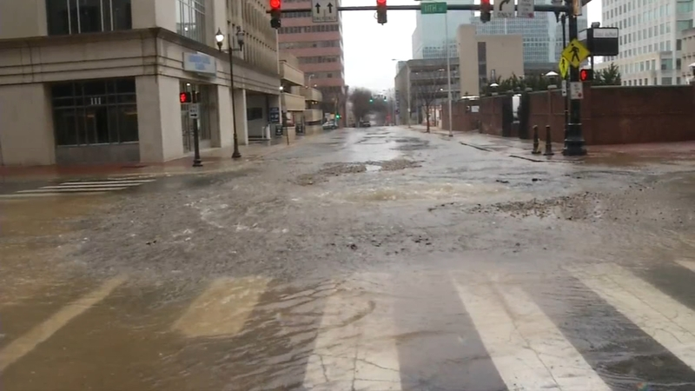
Emergency Responses
Eric Cimo, DelDOT Utilities Engineer
Jerry Nagyiski, DelDOT Chief Traffic Safety Officer
Stephen Wright, Public Works Engineer, Canal District Public Works

Slide 2
Notes:
Poll Title: Do not modify the notes in this section to avoid tampering with the Poll Everywhere activity. More info at polleverywhere.com/support What option below illustrates an emergency? https://www.polleverywhere.com/multiple_choice_polls/e4P1wYeofiVpwnKDvSHAu?state=opened&flow=Default&onscreen=persist

Slide 3
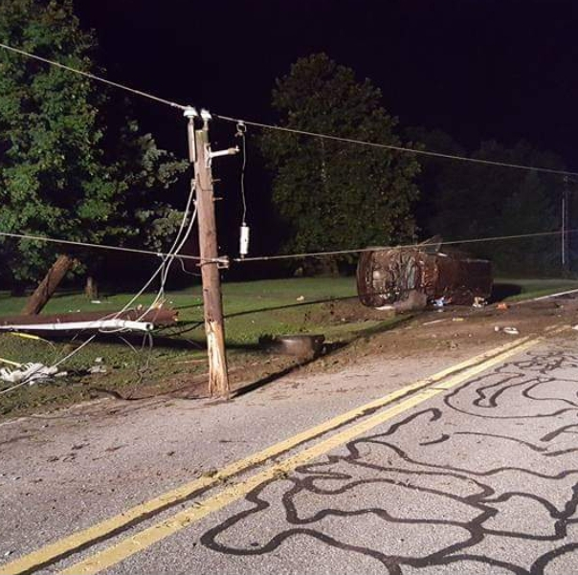
What is an Emergency??
A situation where the safety if the traveling public or general public, or the structural integrity of the highway facility, is placed in immediate danger (as defined in the Delaware Code, Title 26, Chapter 8-the “Miss Utility Law”). (2007 Utilities Manual, Chapter 2)
Any condition constituting a clear and present danger to life, health or property by reason of escaping gas or petroleum products, exposed or broken wires, other breaks or defects in an operator’s utility line or by reason of any disaster of artificial or natural causes. (26 DE Code §802a)
Immediate action required.

Slide 4
Notes:
Poll Title: Do not modify the notes in this section to avoid tampering with the Poll Everywhere activity. More info at polleverywhere.com/support What are some challenges associated with emergency responses? https://www.polleverywhere.com/free_text_polls/nN6zx2EIr2SLD6Rag25nj

Slide 5
Notes:
Poll Title: Do not modify the notes in this section to avoid tampering with the Poll Everywhere activity. More info at polleverywhere.com/support Are emergency situations addressed as quickly as they should be by all parties? https://www.polleverywhere.com/multiple_choice_polls/ezmGL2XlmBCCA34m4puT1?state=opened&flow=Default&onscreen=persist

Slide 6
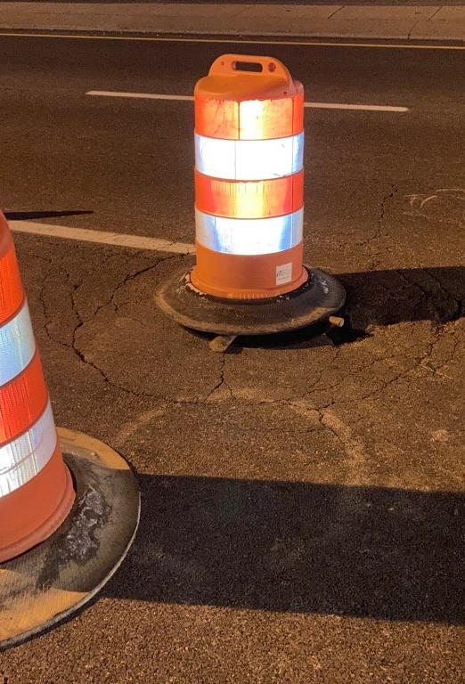
Safety is Paramount
Safety of workers and traveling public is of the utmost importance.
Need to respond immediately to make scene safe as quickly as possible.
Requires quick response from all utilities.

Slide 7
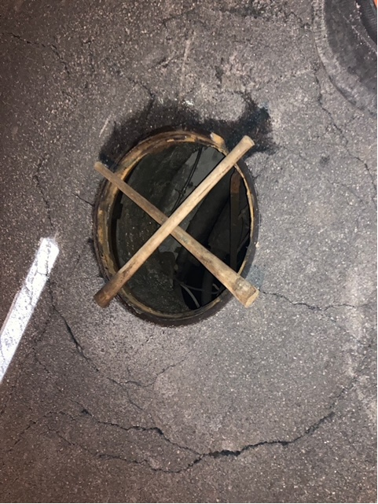
Safety is Paramount
Safety of workers and traveling public is of the utmost importance.
Need to respond immediately to make scene safe as quickly as possible.
Requires quick response from all utilities.
Utility companies need to respond to incident prepared to take control of scene (MOT) and perform work.

Slide 8
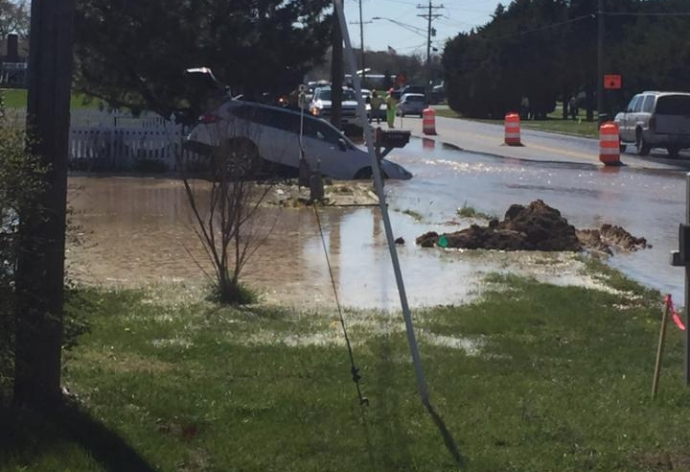
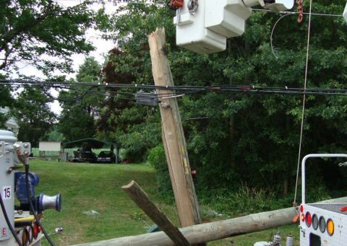
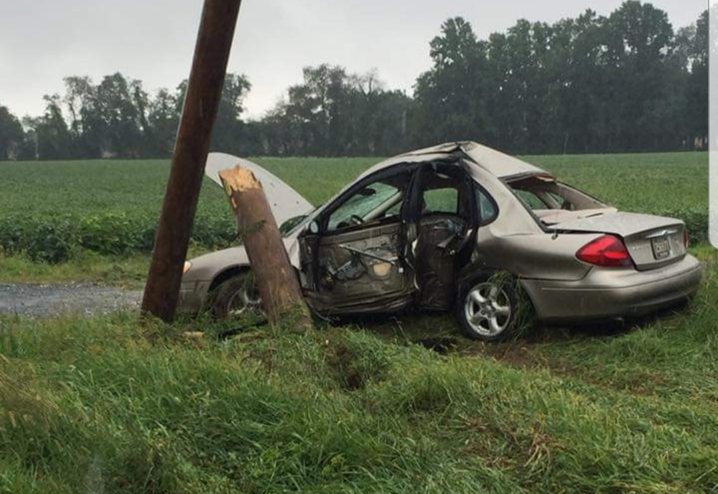
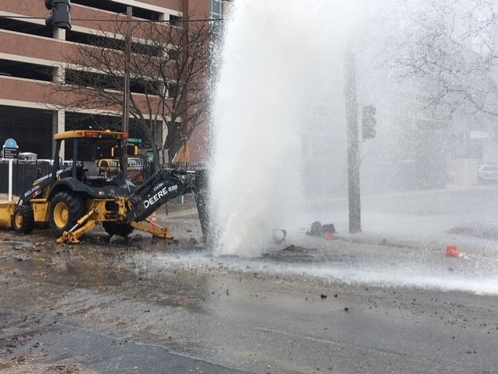
Types of Emergencies
Main Breaks
Downed Cables
Downed Poles
Dig In/Excavator Damage

Slide 9
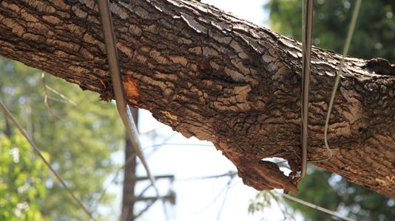
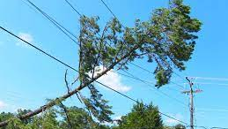
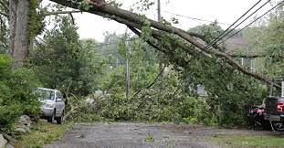
Downed or Leaning Vegetation is Included

Slide 10
DEMUTCD Part 6
DEMUTCD Part 6 Section 6I.01 states:
Traffic incidents can be divided into three general classes of duration, each of with has unique traffic control characteristics and needs. These classes are:
A. Major
-expected duration of more than 2-hours
B. Intermediate
-expected duration of 30 minutes up to 2-hours
C. Minor
-expected duration under 30 minutes

Slide 11
Reality…
Most utility emergencies fall into the Major class

Slide 12
THINGS TO NOTE
Many times, DelDOT is on scene and has established traffic control. Please note this is temporary in nature.
If the emergency falls into the Major category; mobilize your MOT immediately to take over for DelDOT.
Contact DelDOT’s Transportation Management Center (TMC) at 302-659-4600 or #77 and the DelDOT Public Works Inspector to establish a points of contact.
Stay in contact with the TMC on any changes and give hourly updates
Notify TMC once all work has been completed and the road/lane/shoulder has been reopened.

Slide 13
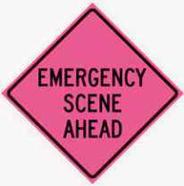
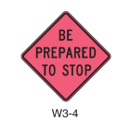
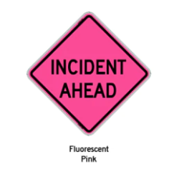
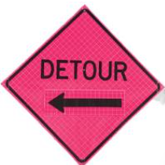
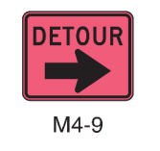
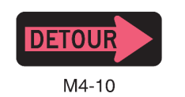
Primary Functions of Temporary Traffic Control Devices During an Incident
Inform road users of the incident
Provide guidance information on the path to follow
Notes:
discuss the reason for providing this...that establising a defined path for motorist around the incident helps protect the utility workers and lesions driver frustrations. Providing guidance around the incident scene also reduces the chance for secondary crashes.

Slide 14
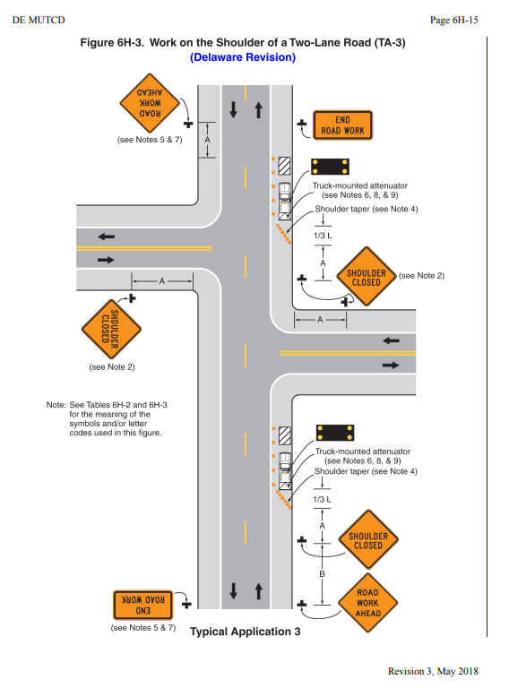
TYPICAL APPLICATIONS
TA-3; shoulder closure on a two-lane two-way road

Slide 15
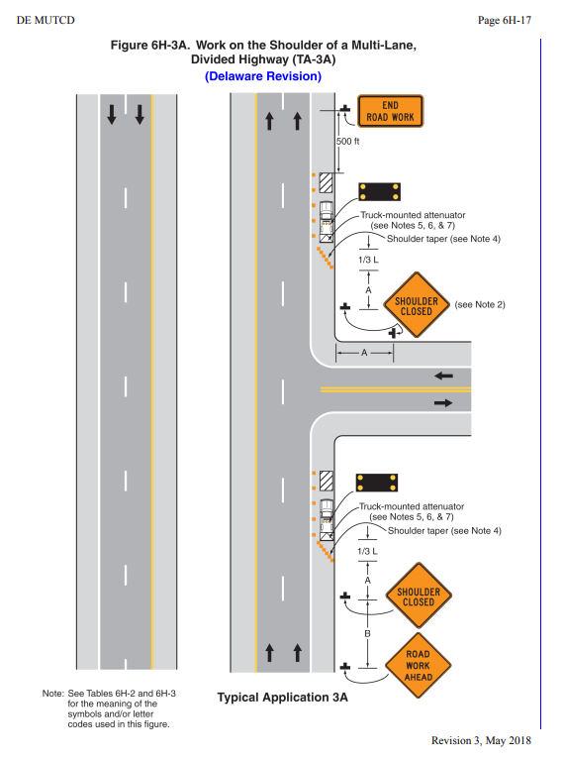
TYPICAL APPLICATIONS
TA-3A; shoulder closure on a multi-lane divided highway

Slide 16
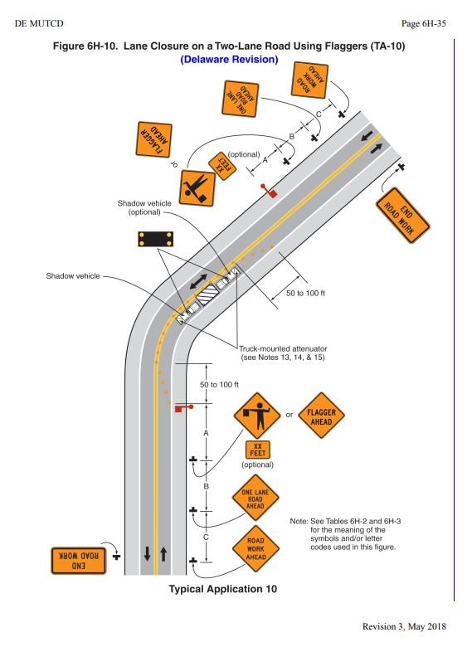
TYPICAL APPLICATIONS
TA-10; lane closure on a two-lane two-way road

Slide 17
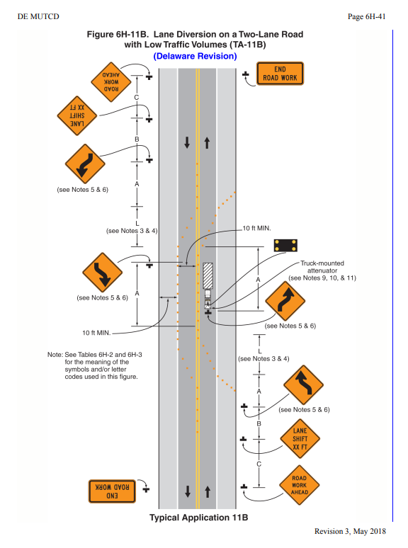
TYPICAL APPLICATIONS
TA-11B; lane shift on a two-lane two-way road

Slide 18
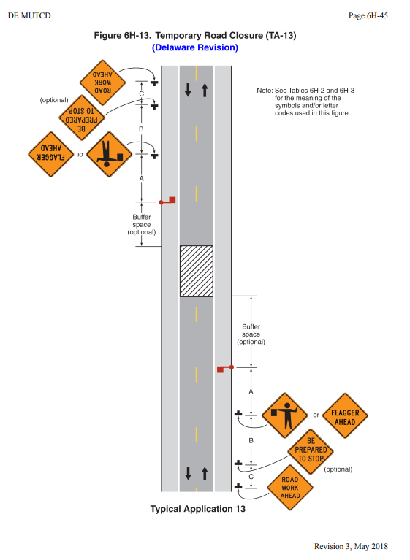
TYPICAL APPLICATIONS
TA-13; temporary, 15-minute road closure on a two-lane two-way road

Slide 19
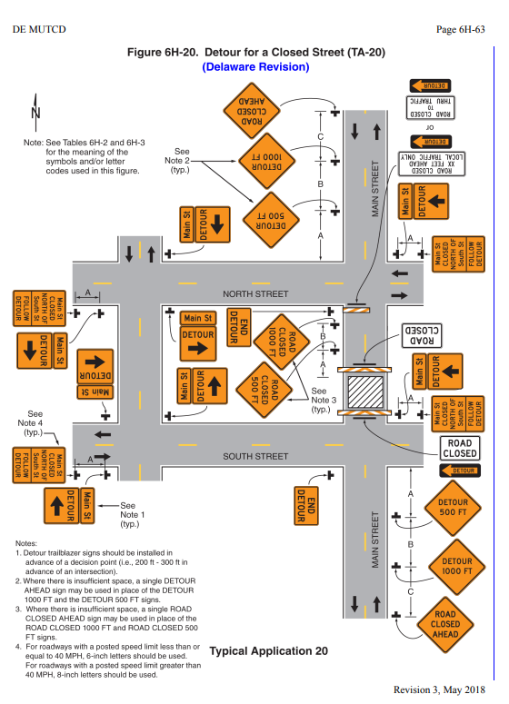
TYPICAL APPLICATIONS
TA-20; detour template

Slide 20
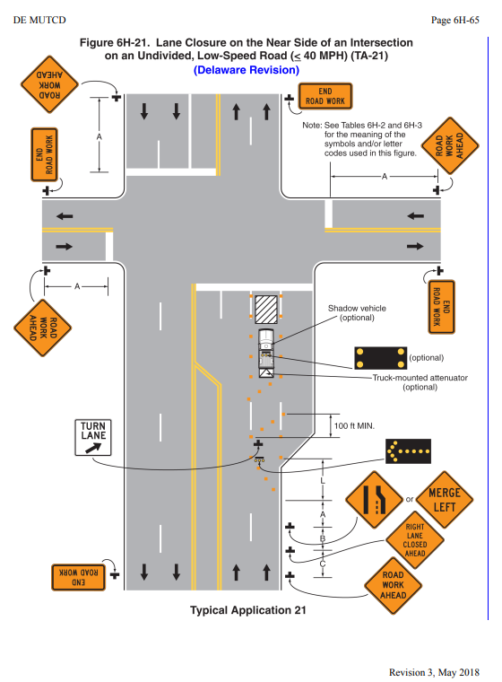
TYPICAL APPLICATIONS
TA-21; lane closure at an intersection on low-speed, multi-lane road

Slide 21
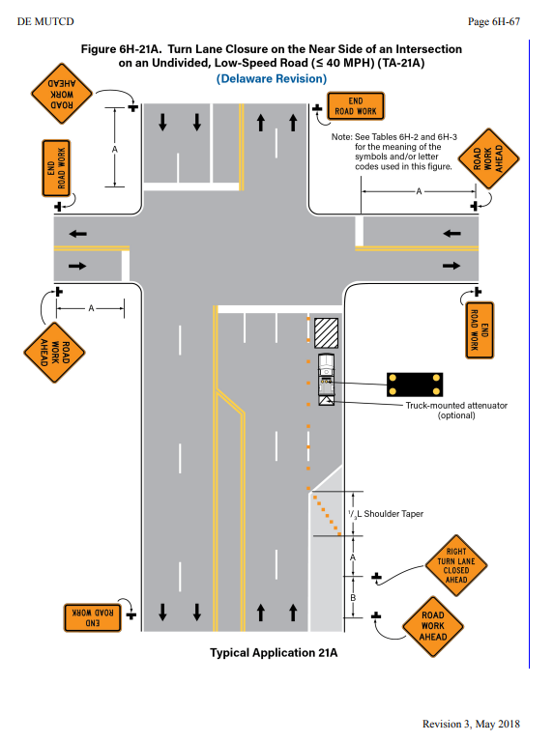
TYPICAL APPLICATIONS
TA-21A; turn lane closure

Slide 22
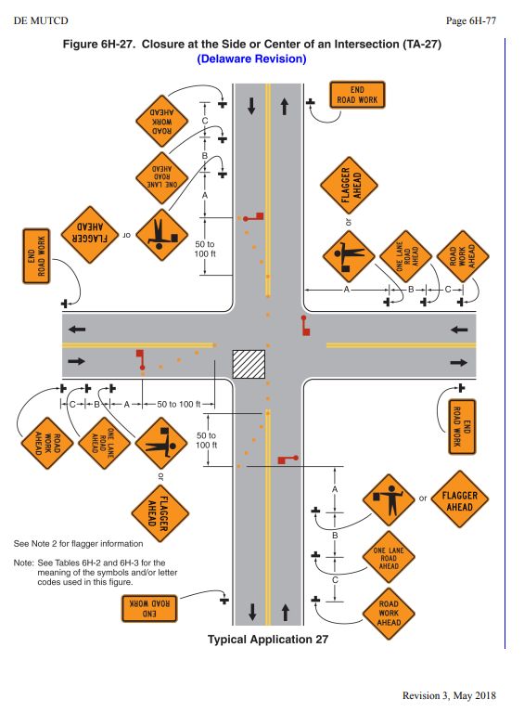
TYPICAL APPLICATIONS
TA-27; flagging a two-lane two-way non-signalized intersection

Slide 23
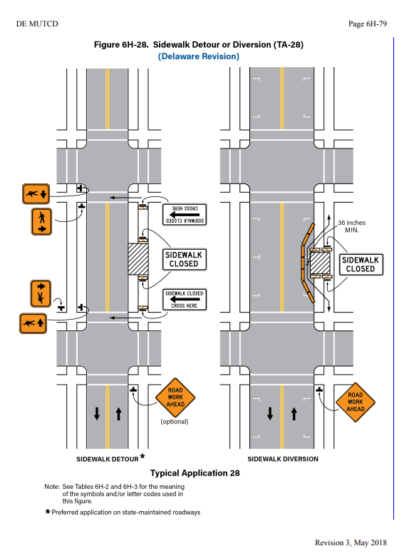
TYPICAL APPLICATIONS
TA-28; sidewalk detour or diversion

Slide 24
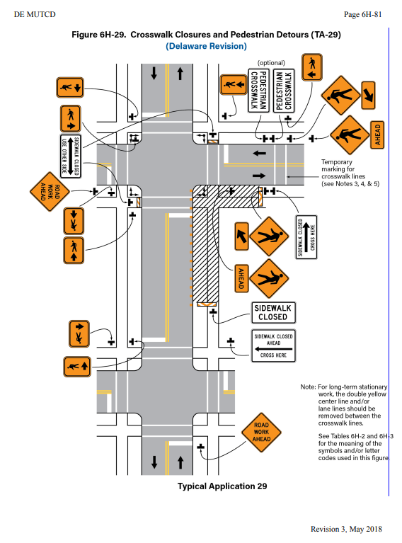
TYPICAL APPLICATIONS
TA-29; crosswalk closure and pedestrian detours

Slide 25
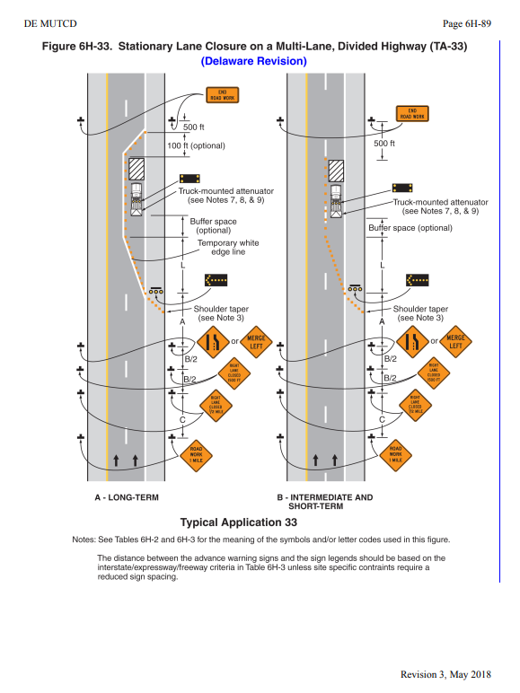
TYPICAL APPLICATIONS
TA-33; lane closure on a multi-lane divided highway

Slide 26
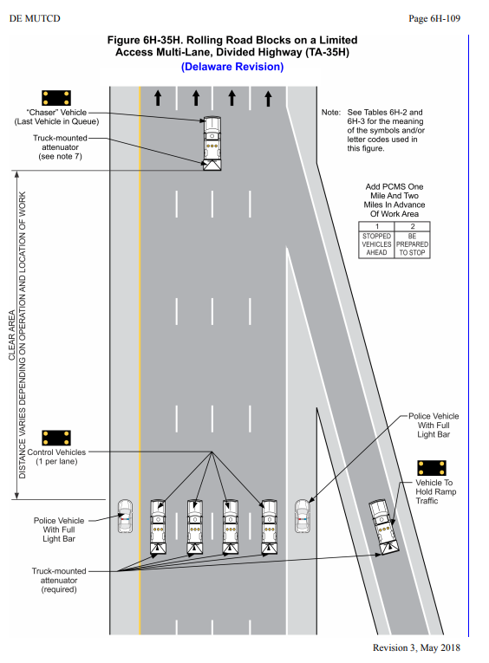
TYPICAL APPLICATIONS
TA-35H; rolling roadblocks

Slide 27
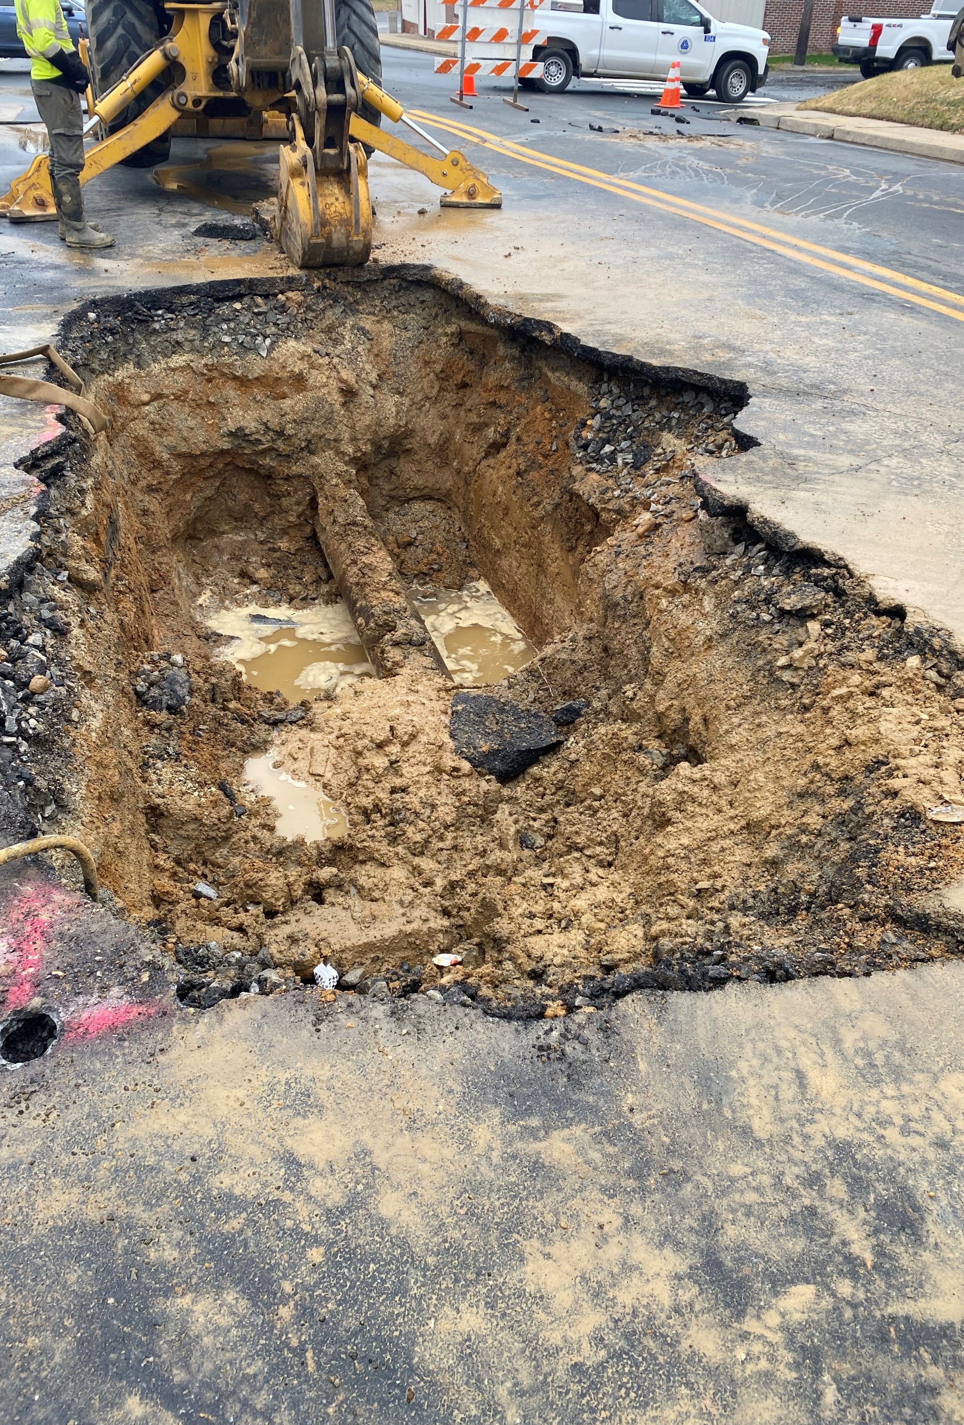
Emergency Assessment
Secure the site
Establish your Maintenance of Traffic as soon as possible
If DelDOT is not already present, contact us
Be prepared to tell us the location
Be prepared to tell us the nature of the emergency
Be prepared to tell us the current impact to traffic
DelDOT tracks interruptions in traffic via the TMC
Always remember that it’s a Right-of-Way, you have the right to be there, but so does everyone else. Expect to deal with the public on all projects.

Slide 28
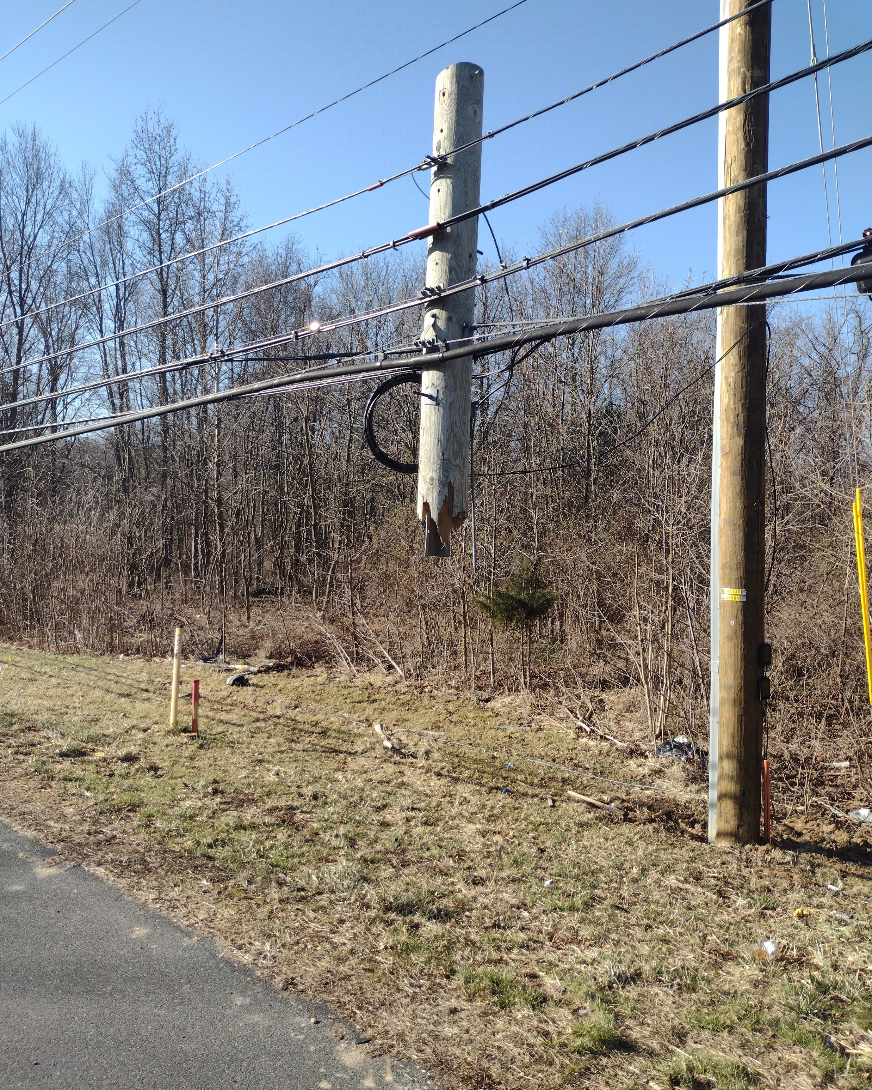
Emergency Permits
District PW office is to be notified of all emergency utility work
Emergency permit shall be submitted ASAP. If work performed after hours, permit should be submitted the following business day to outline everything
Permit and associated restoration will be inspected and tracked per the Manual
Public Works inspectors will determine the scope of the repair needed to the right-of-way

Slide 29
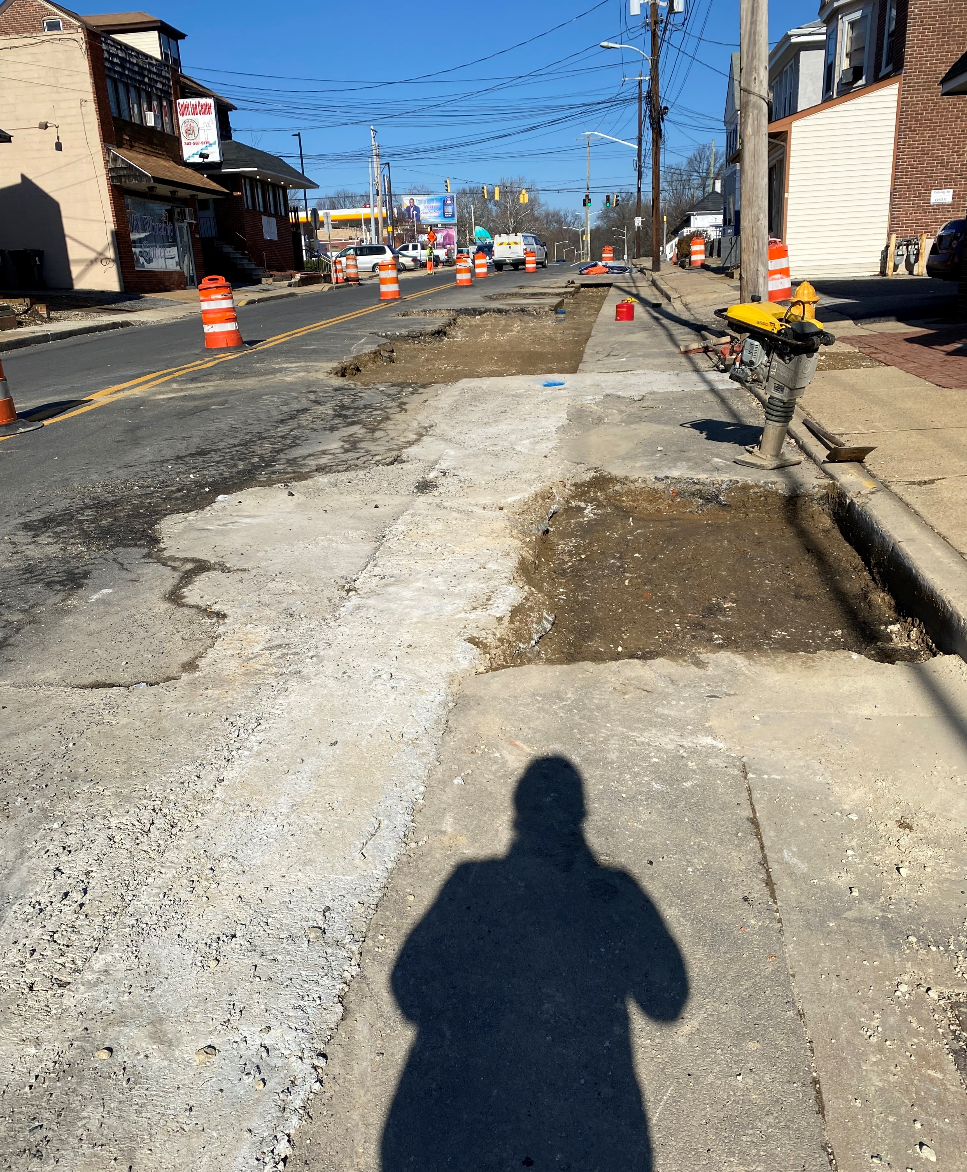
Scope of Work
Maintenance of Traffic must be maintained until site is restored to a safe condition
Public Works inspector will be on-site to determine the scope of repairs
No steel plates during the winter
When the asphalt plants close, anticipate pouring concrete for underground work
Compaction is critical
All utility work has a three-year warranty per permit

Slide 30
Notes:
Poll Title: Do not modify the notes in this section to avoid tampering with the Poll Everywhere activity. More info at polleverywhere.com/support What is an acceptable utility response time in an emergency situation? https://www.polleverywhere.com/free_text_polls/a0tyt9bhrWOFV4j0Ggkss

Slide 31
Notes:
Poll Title: Do not modify the notes in this section to avoid tampering with the Poll Everywhere activity. More info at polleverywhere.com/support What can be done to improve utility emergency response times? https://www.polleverywhere.com/free_text_polls/A6qt4FePnx2TjeS5r8KND

Slide 32
Changes Needed
Need to improve on emergency responses.
Will be working with companies.
Verify emergency contact numbers and company no response escalation processes.
Everyone needs to work together for the safety and overall good of our constituents.

Slide 33
Moving Forward
Utility Manual revision to contain additional requirements related to emergency responses.
DelDOT is working to create a policy to address issues more immediately.

Slide 34
Under Consideration
DelDOT Notification to Utility OR Utility Notification to DelDOT
Utility Response Timeframes
Verbal
On-site & Performing Work
Utility to Establish MOT & Take Over Scene
Utility to Keep DelDOT and Other Utilities Updated on Status
Accountability for Nonconformance

Slide 35
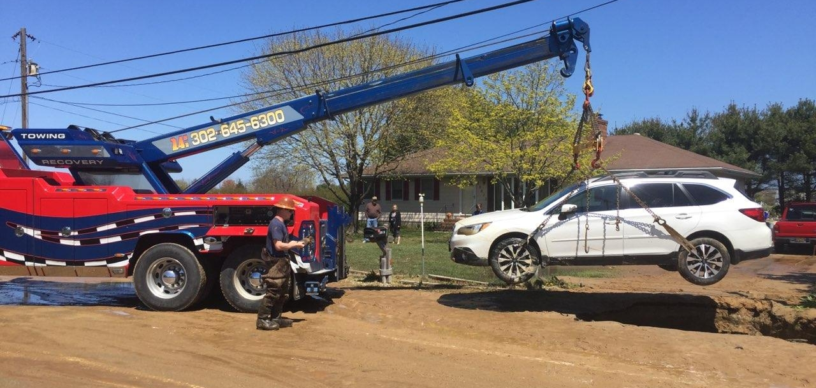
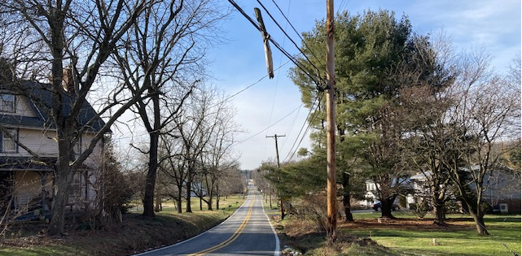
Thank You!
Eric Cimo – Utilities Engineer; 302-760-2642; eric.cimo@delaware.gov
Gerald A. Nagyiski – DelDOT Chief Safety Officer; 302-222-5977;
gerald.Nagyiski@delaware.gov
Stephen Wright – Canal District Public Works Engineer; 302-326-4679;
stephen.wright@delaware.gov
DE MUTCD: https://deldot.gov/Publications/manuals/de_mutcd/index.shtml

